Slide 1

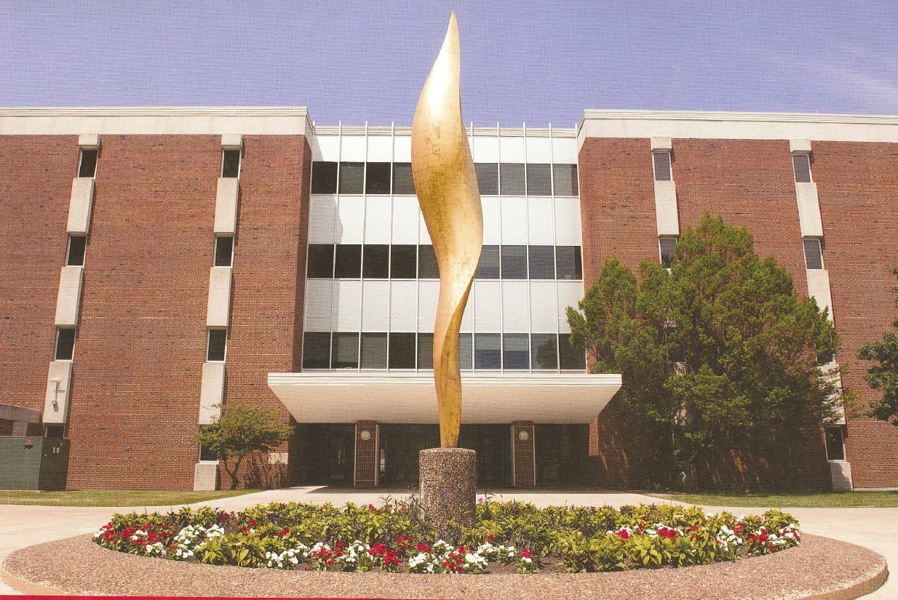
College of Arts and Sciences
FY19 Annual Report
FY20 Planning Document
Collaboration

Slide 2

Leadership Team
College Office
Diane Zosky – Interim Dean
Marla Reese-Weber – Associate Dean
Sally Parry – Associate Dean
Joe Blaney – Associate Dean
Debbie Fox – Assistant Dean
Carrie Wieburg – Director CAS Business & Finance
Tammy Hansen – Administrative Aide
Rebecca Brown – Office Support Specialist
Mike Regilio- Director CAS-IT
Stephanie Sellers – Director of Development
Chairs and Directors
Craig Gatto – BSC
Craig McLauchlan – CHE
Steve Hunt – COM
Ann Beck – CSD
David Cleeton – ECO; Rachel Bowden-Acting Chair
Chris De Santis – ENG
Dagmar Budikova – GEO
Ross Kennedy – HIS
Bruce Burningham – LAN; Juliet Lynd- Acting Chair
George Seelinger – MAT
Chris Horvath – PHI
Dan Holland – PHY
T. Y. Wang – POL
Scott Jordan – PSY
Joan Brehm– SOA, Interim Chair
Doris Houston – SWK, Interim Director
Alison Bailey – WGS; Kyle Ciani- Acting Program Dir.

Slide 3
Academic Units
Sciences and Mathematics
Biological Sciences
Chemistry
Geography, Geology, & the Environment
Mathematics
Physics
Social Sciences
Communication Sciences &
Disorders
Economics
History
Politics & Government
Psychology
Social Work
Sociology & Anthropology
Humanities
Communication
English
Languages, Literatures, &
Cultures
Philosophy
Interdisciplinary
African-American Studies, Latin American & Latino/a Studies, Women’s & Gender Studies

Slide 4
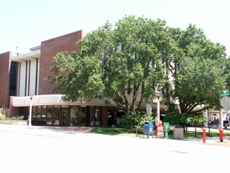
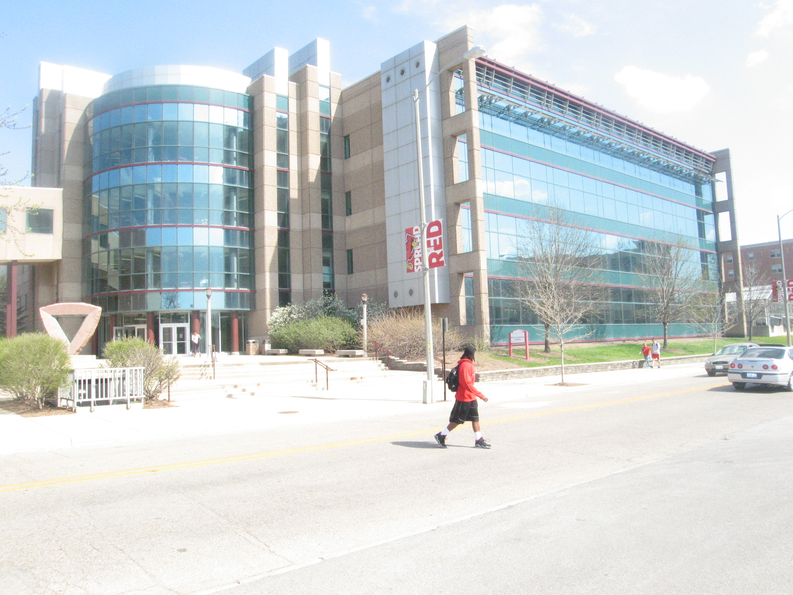
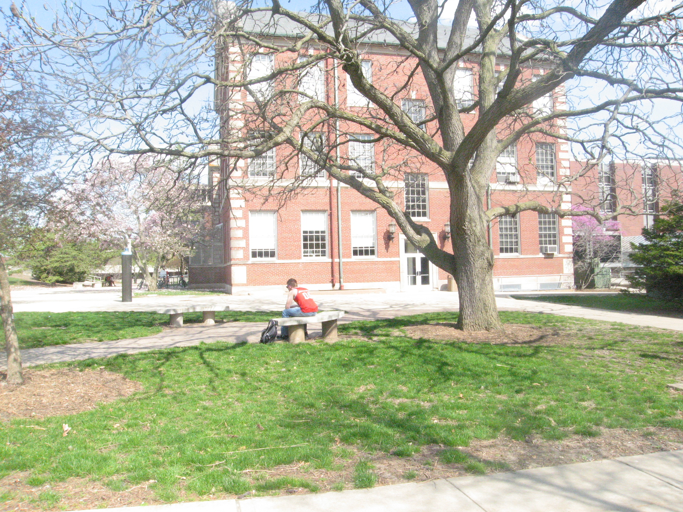
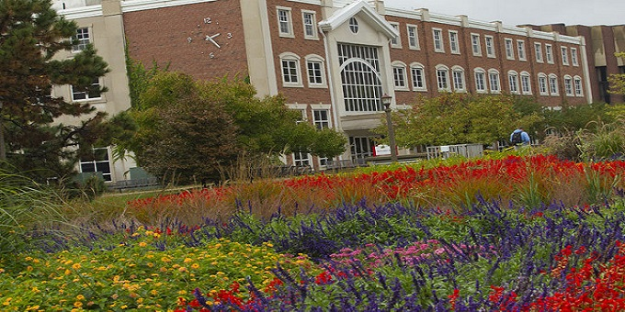
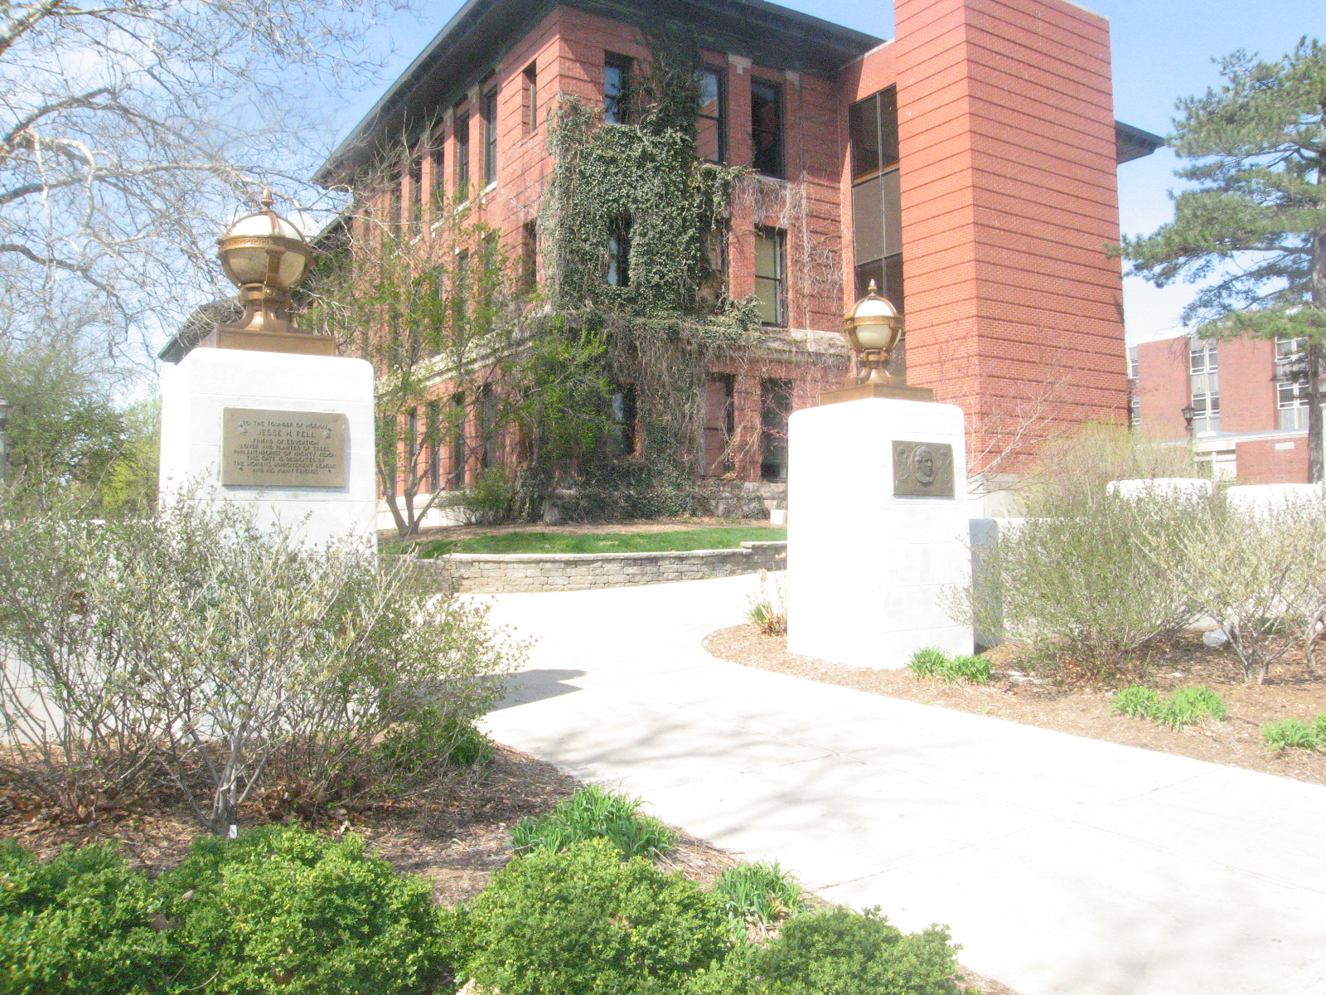
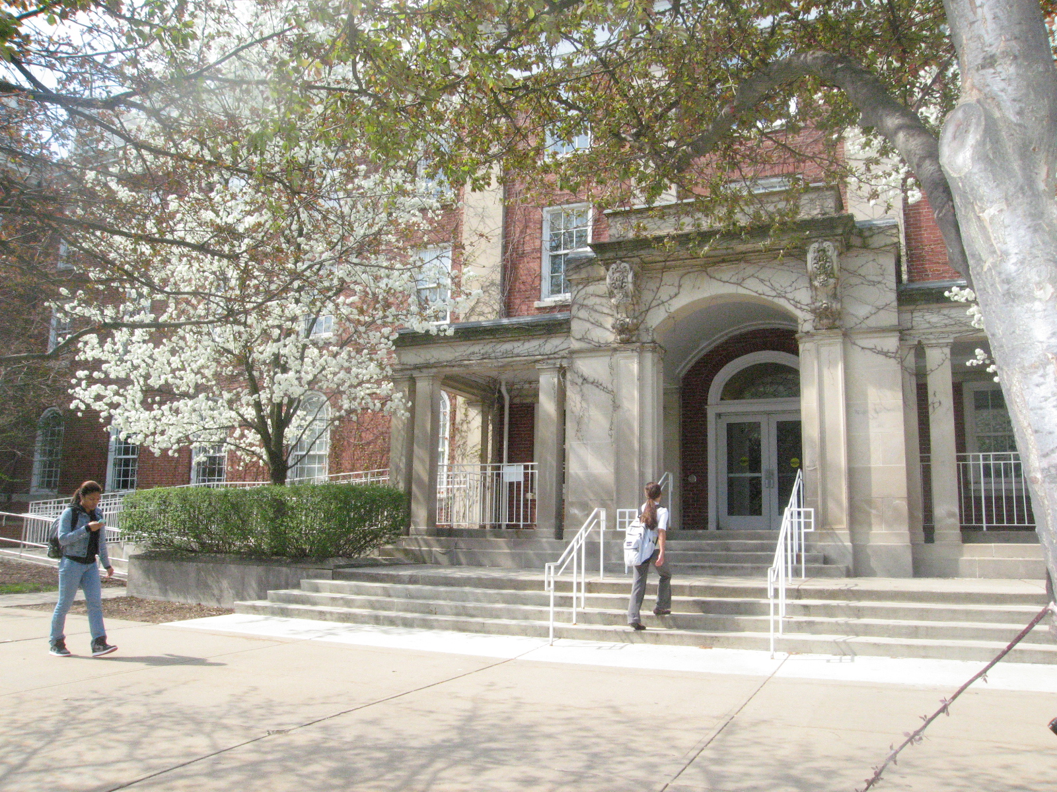
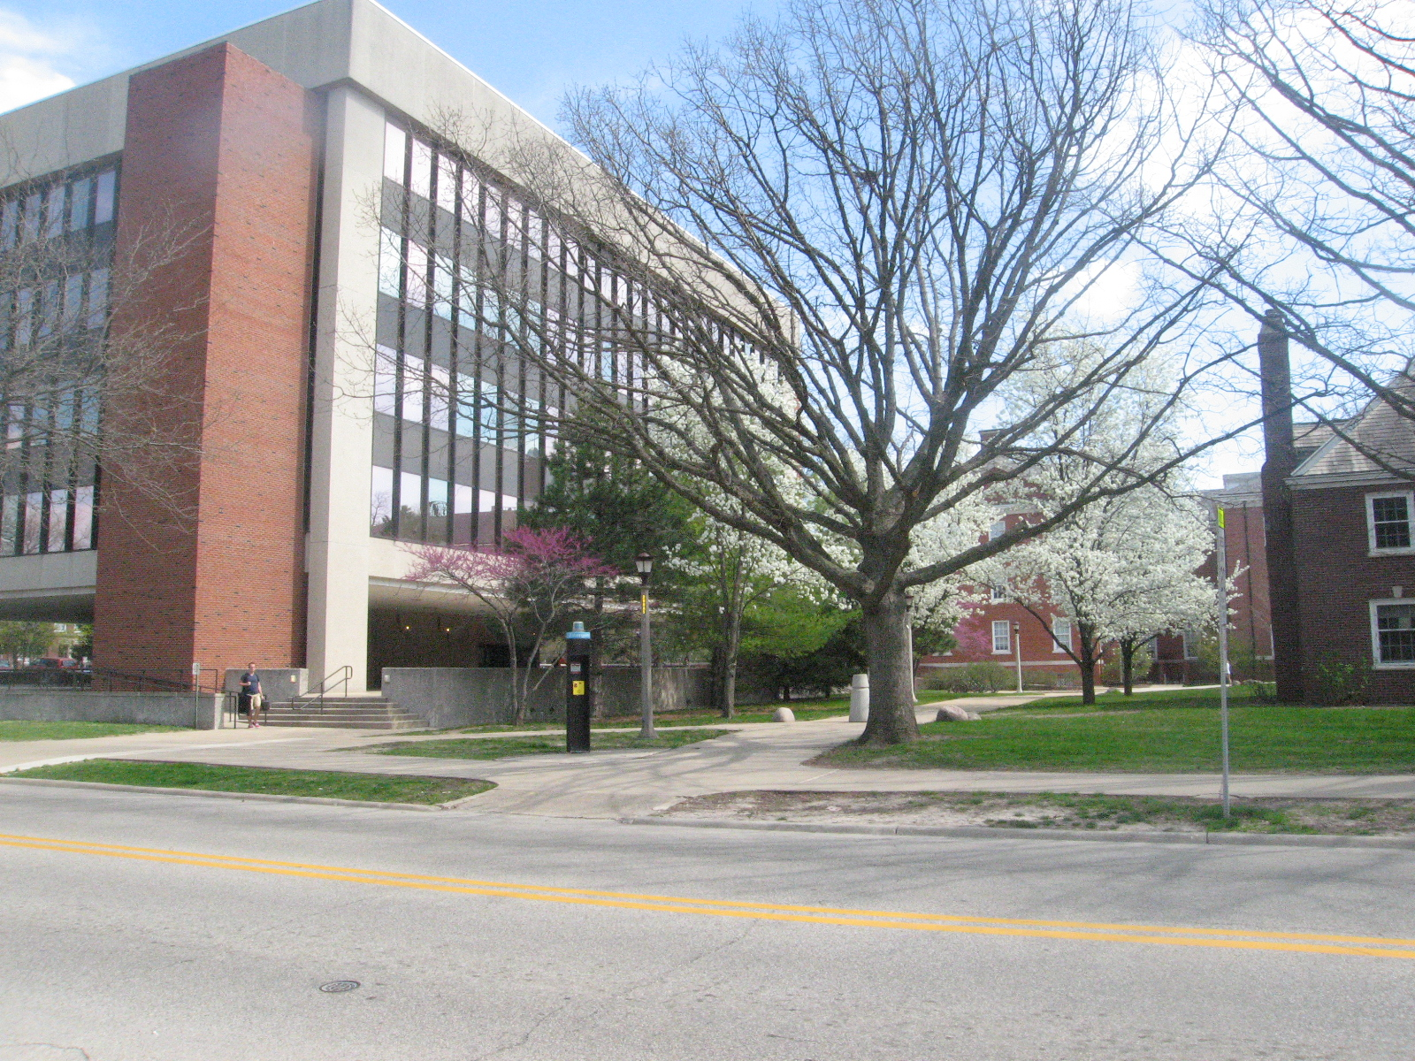
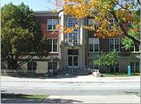
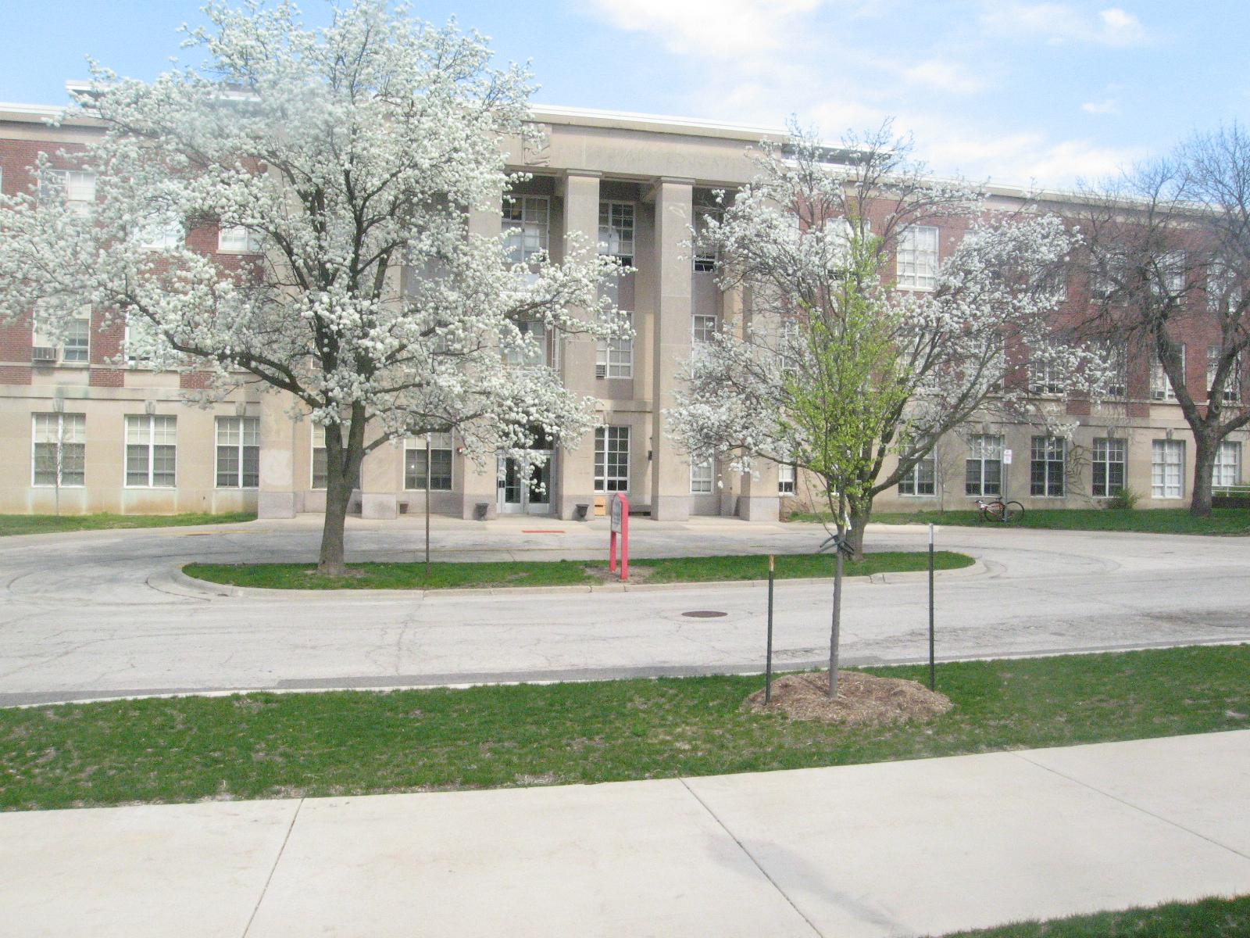
Julian Hall
Science Lab Building
Felmley Hall
Schroeder Hall
Moulton Hall
Fell Hall
DeGarmo Hall
Rachel Cooper
Fairchild Hall

Slide 5
CAS Population
6,166 Students
311 Tenure Track Faculty
225 Non-Tenure Track Faculty
50% of all ISU’s credit hours (257,701)
Deliver 85% of all general education

Slide 6

Bone Scholars
Emily Ferguson (CSD)
Morgan Grunloh (CHE)
Kelsie Klingenberg (ECO)
Torrey Saxton (MAT/PHY)
Joseph Syzdek (GEO)
Noah Tang (HIS)
Rachel Angles (CHE/BSC)

Slide 7
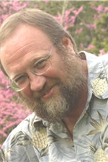
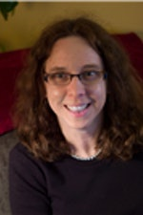
Faculty Awards
College of Arts and Sciences Distinguished Lecturer
Dan Liechty
School of Social Work
Alison Bailey
Women’s and Gender Studies

Slide 8
Major Accomplishments in FY19
The Art Station
  The Illinois Art Station continued to grow, including acquiring permanent space, the hiring of a Curator of Education, providing graduate assistantships to 17 students, serving over 1,200 children in the community of which 25% were from underrepresented populations.
Courageous Classroom Conversations
  75% participation
Increase in diversity of new hires
  33% of new hires contribute to diversity and inclusion mission
Foundation and Capital Campaign milestones!!!

Slide 9
Major Accomplishments in FY19
Instructional Capacity
  $194,167 College SBC and Variance
  $550,834 Dept./School SBC & Variance
External Grants
  86 grants awarded
  $4,908,785 total funds
  $764,819 indirect costs
Foundation Funds
  $3,172,519 raised in FY19
  $19,993,761 raised for campaign goal
  Birds Give Back $33,951

Slide 10
Major Accomplishments in FY19
Scholarly Outputs
  4.45 per TT
  Approximately 35% with student co-authors
Faculty Travel (~ $260,000 GR)
  Professional
  International
Student Travel (~ $40,000 GR)
  Undergraduate
  Graduate
  Team

Slide 11
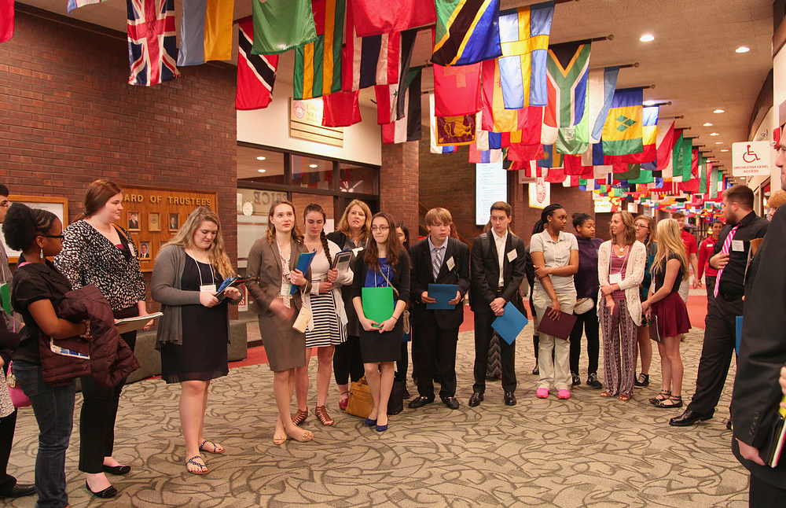
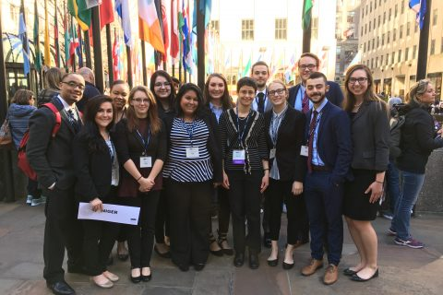
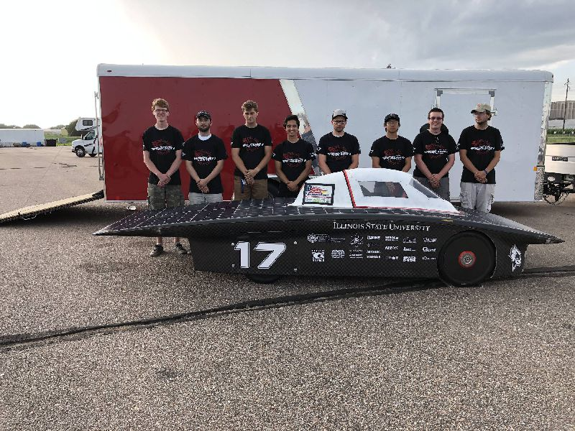
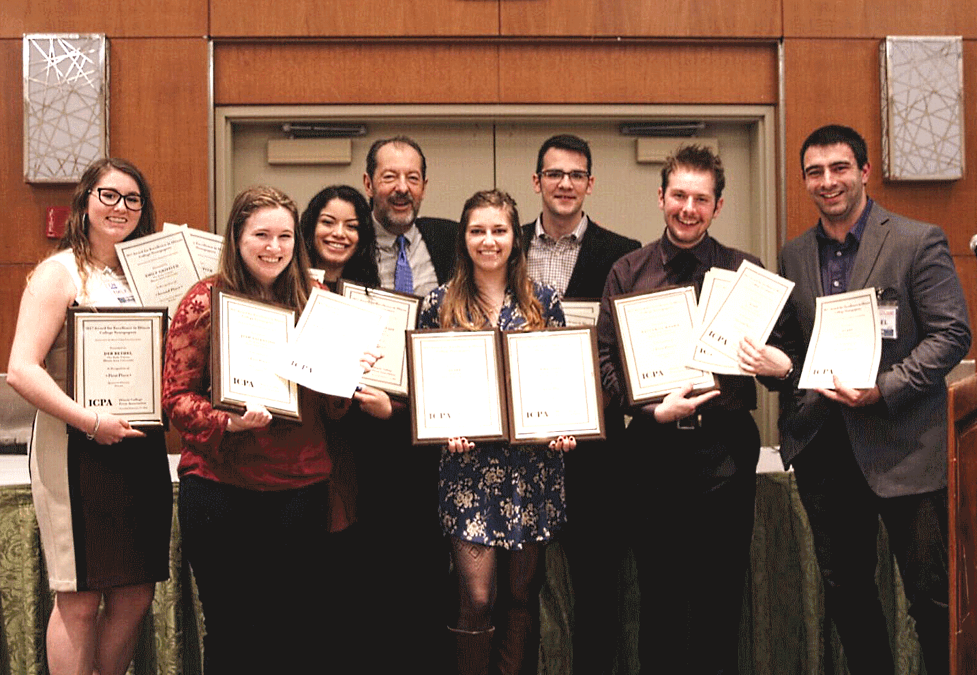
Student Teams
Illinois Capitol Forum on America’s Future
Model UN
The Vidette
Solar Car

Slide 12
Major Projects in FY19

Slide 13
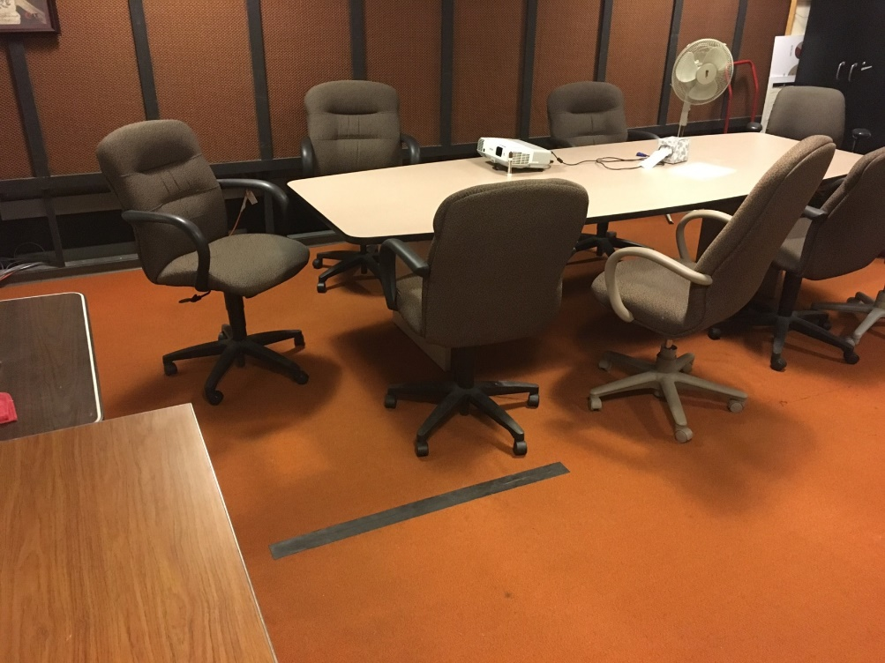
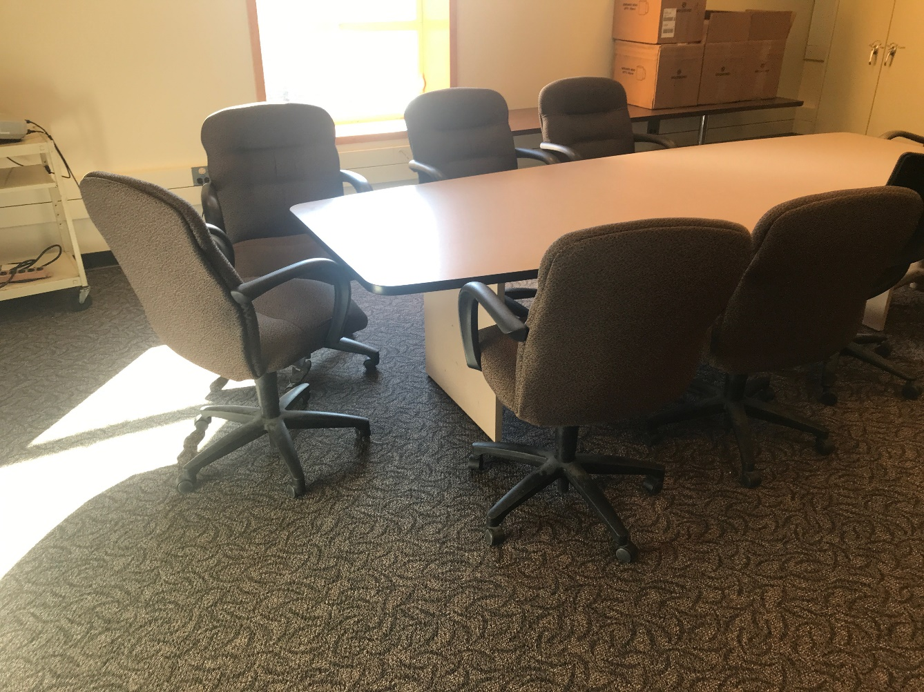
WGLT
Before
After

Slide 14
Faculty Professional Development Series
Pre-Tenure Faculty
Introduction to the College Services
Tips for Being a Better Teacher
Understanding Annual Evaluations
Research for the Pre-Tenured Scholar
Incorporating Service into Your Career
Tenure & Promotion Process
Post-Tenure Faculty
Interdisciplinary Opportunities
Inclusive Teaching
Expectations for Full Professors
Nuts and Bolts of T & P Application

Slide 15
Main Street College
Events are designed to showcase faculty expertise to the larger community

Slide 16
FY20 Planning

Slide 17
Permanent Requests
CAS-IT Salary adjustments - $45,521
Latin American and Latino/a Studies Program - $143, 000
Graduate Stipends - $250,000
Startup Costs - $150,000
Faculty Summer Stipends - $200,000
CSD Academic Advisors - $64,800
GEO Part-time CS office support position - $12,000

Slide 18
Permanent Requests
Supplemental summer salary support –
Planetarium Director from 9 to 12 mos.
ENG Ed Director from 9 to 10 mos.
ECO summer pay for advisor for recruitment/retention
CHE stockroom assistant supplement
WZND Audio Engineer
Chemical Inventory software
PHY Lab support staff

Slide 19
Provost Enhancement Requests
CAS SLB expansion and renovation - $100,000
Startup Costs - $150,000 (CAS=$200,000)
Interdisciplinary Programs - $40,000 (CAS=$25,000)
Recap Faculty/Staff Computers - $80,000 (CAS=$31,000)
Recruitment/retention support - $16,000 (CAS=$16,000)
Student Teacher Supervision Travel - $45,770

Slide 20
Provost Enhancement Requests
Facilities upgrades:
GEO FHA 420 - $71,800 (GEO=$35,000)
SWK FH 301 - $65,658
COM FEL 052 lab - $42,719 (COM=$5,500)
COM FEL 102 lab - $24, 247 (COM=$6,000)
WGLT vehicle - $25,800
The Vidette - $300,000
GEO Scanning Electron Microscope - $471,744

Slide 21
Latin American and Latino/a Studies
African-American Studies
Climate Report action item was to expand and provide resources and funding for Latino/a Studies, Women’s and Gender Studies, African-American Studies and LGBT Queer Studies
LGBTQ Institute - $15,000
African American Studies Program - $12,500 from Provost/$12,500 from CAS
Latin American/Latino/a Studies - $12,500 from Provost/$12,500 from CAS
Director salary, graduate assistant support, and operating budget

Slide 22



Recruitment and Retention
Many departments/schools requested funds for recruitment and retention
Promotion of IDS minors
Design and printing costs, postage, promotional goods, and travel funds

Slide 23
Tenure Track Priority Criteria
Failed search in FY19??
Enrollment metrics
  Enrollment in recent years
  Enrollment-growth potential
  Average credit hours per tenure track
  Total credit hours generated
Average annual course load per faculty member
External pressures (e.g., accreditation)
Programmatic needs
Recent trends in faculty base (hires, retirements, etc.)
New department/school leadership

Slide 24
Tenure Track Priority Requests
Science and Mathematics
BSC BSC GEO MAT PHY | Evolutionary Biologist Conservation Biologist Urban/Reg. Planning Statistics Computational Physics
Social Sciences
ECO HIS POL PSY PSY SOA SOA SWK SWK LALS | Macro/Time Series History of Science Legal Studies School Psychology Clinical Counsel/Quant Political Inequality Race and Ethnicity Social Work Practice Practice with Latinx
Humanities
ENG | Histories of Rhetoric
ENG | American Comp. Lit & Cult
PHI | Philosophy of Science

Slide 25
Non-Tenure Track Requests
Unit | Courses
BSC | BSC 101, 196, 197, 212, 286
BSC | BSC 101, 160, 170, 181, 182, 202
COM | COM 110
COM | COM 110
GEO | GEO 135, 142
PHI | PHI 101, 224, 238
WGS | WGS 120

Slide 26
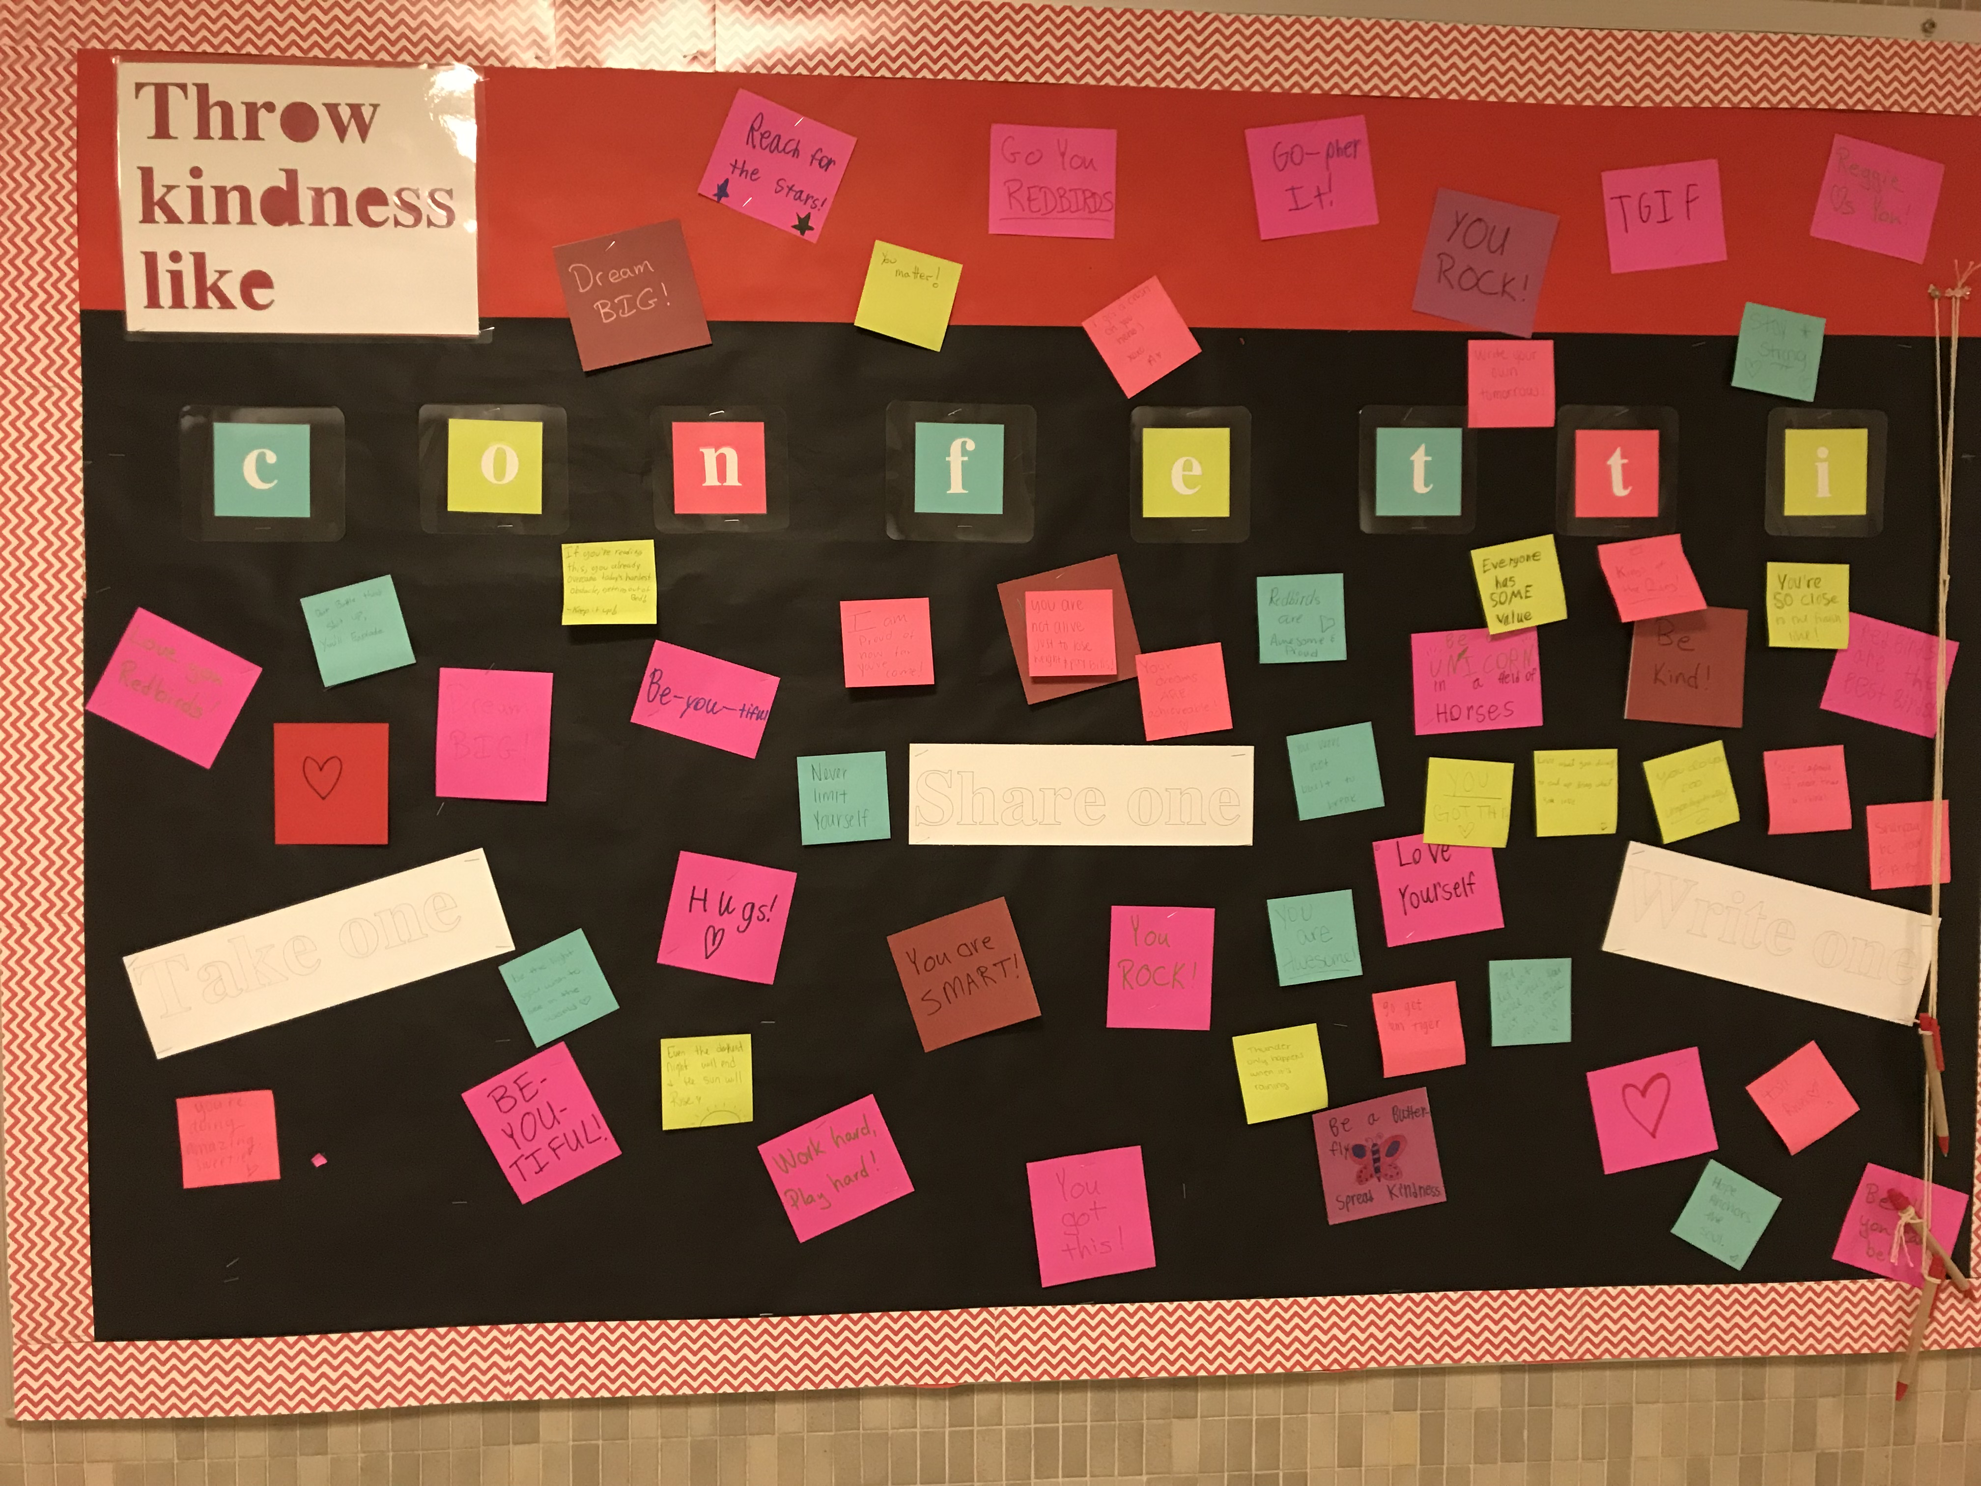
CAS is Reclaiming Kindness

Slide 27
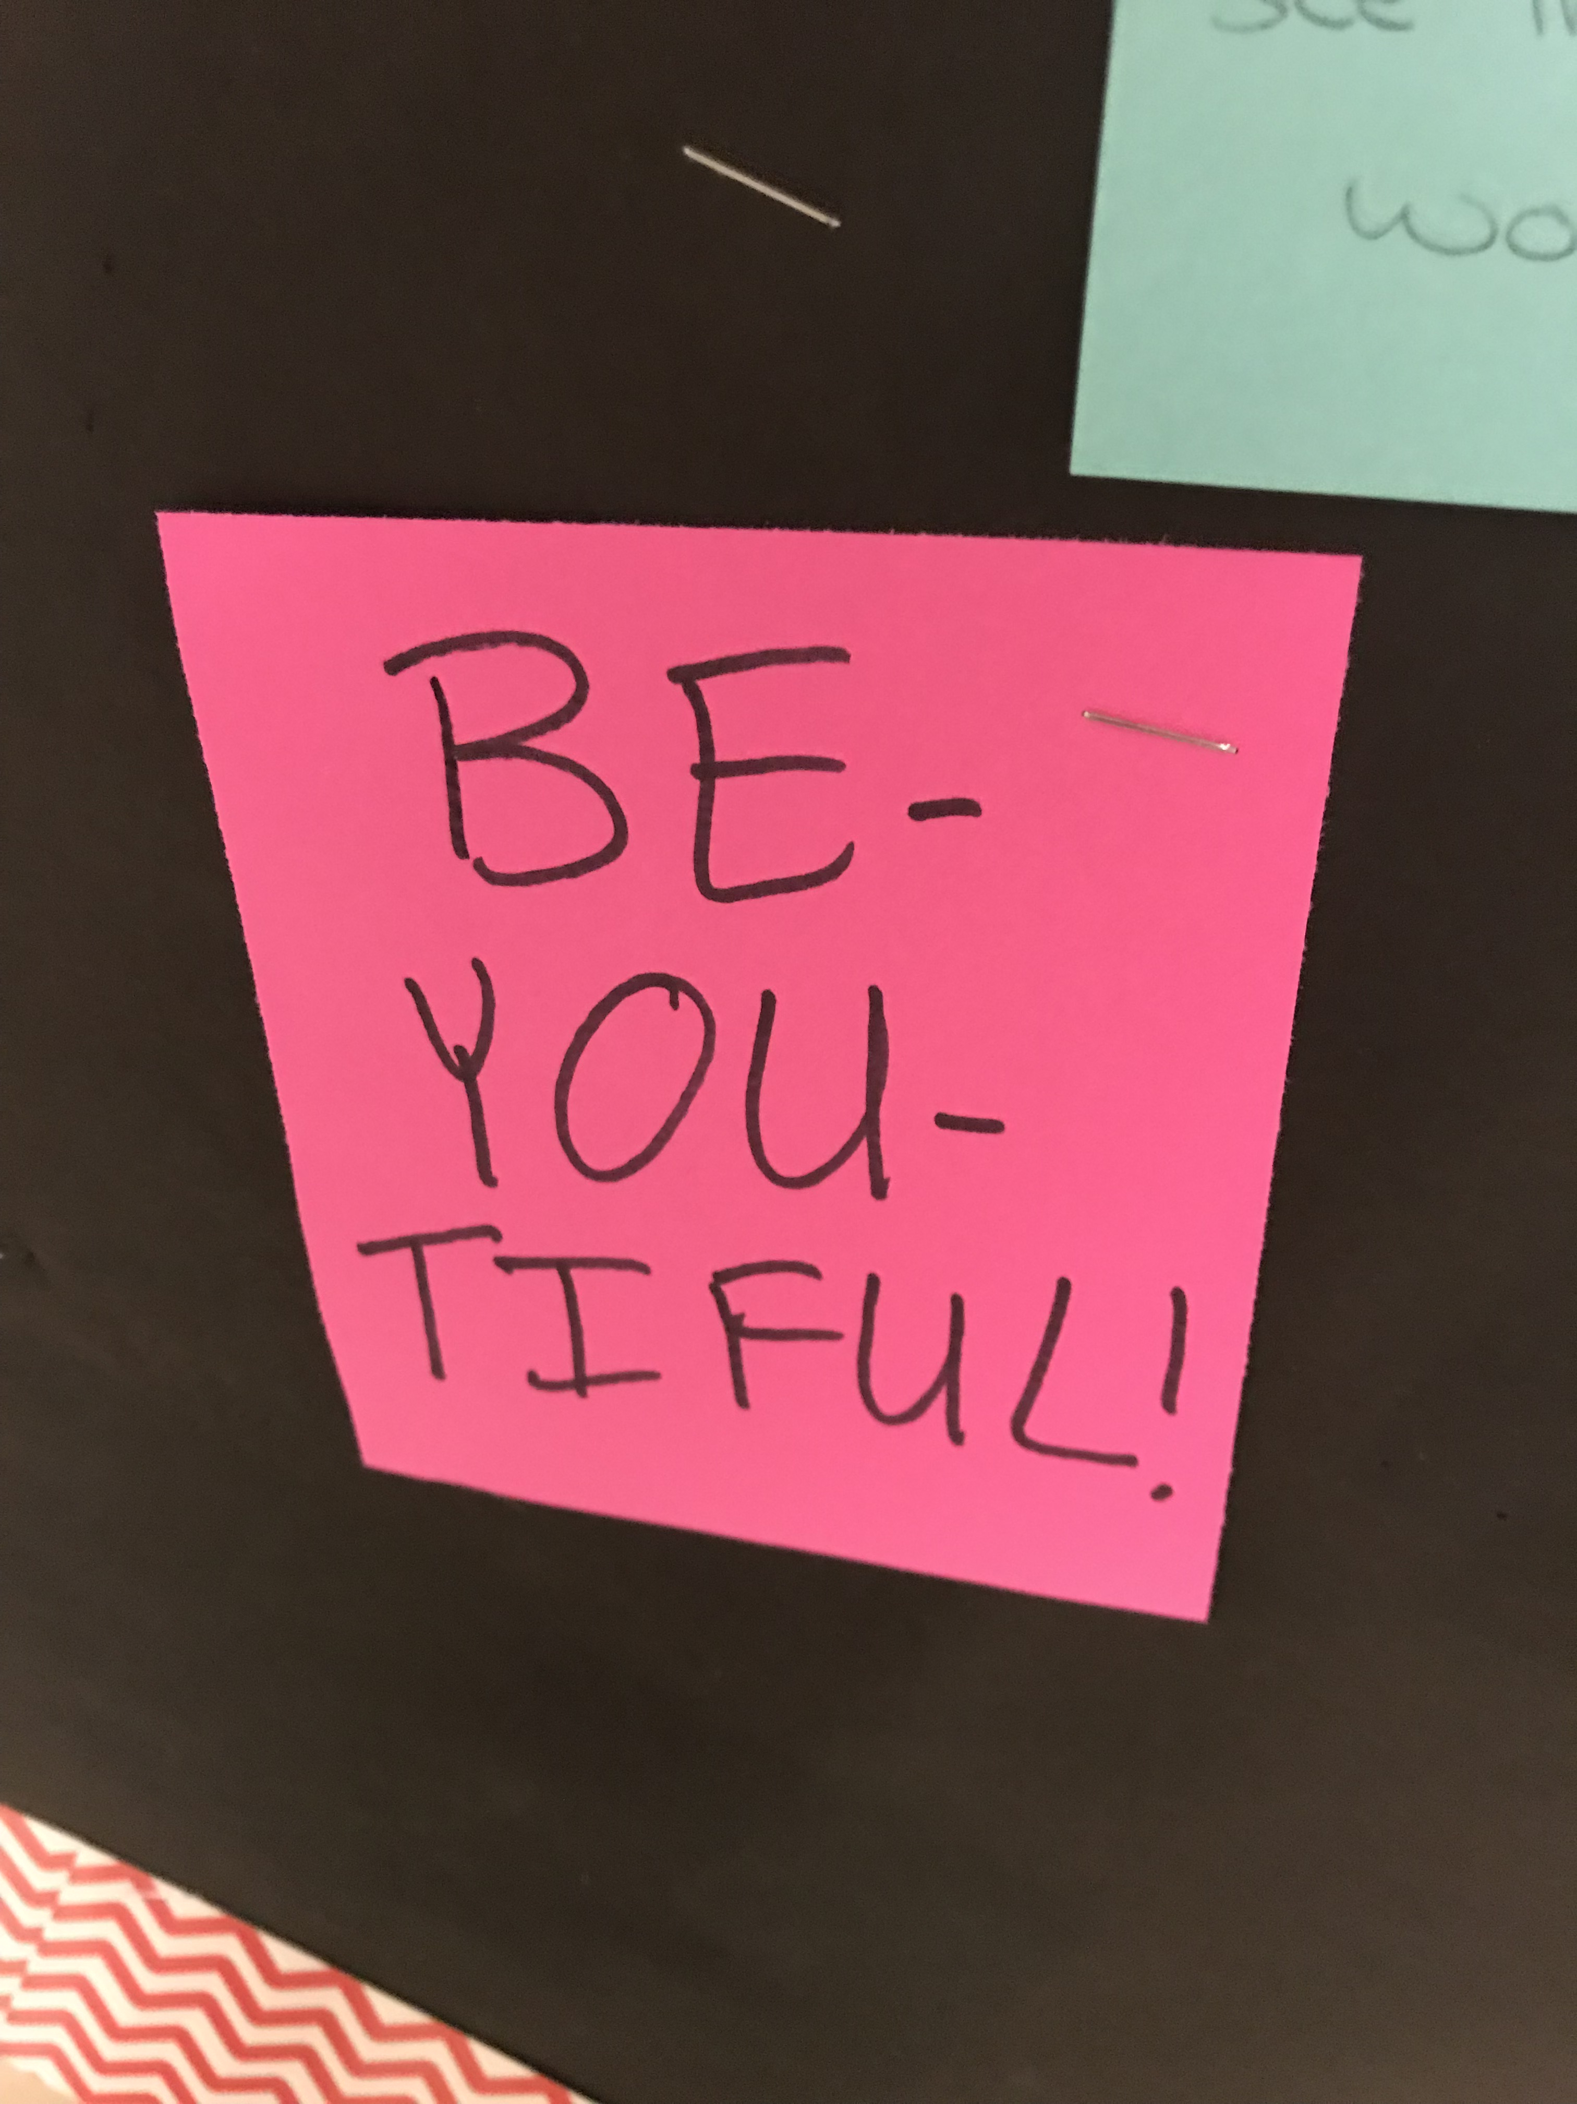
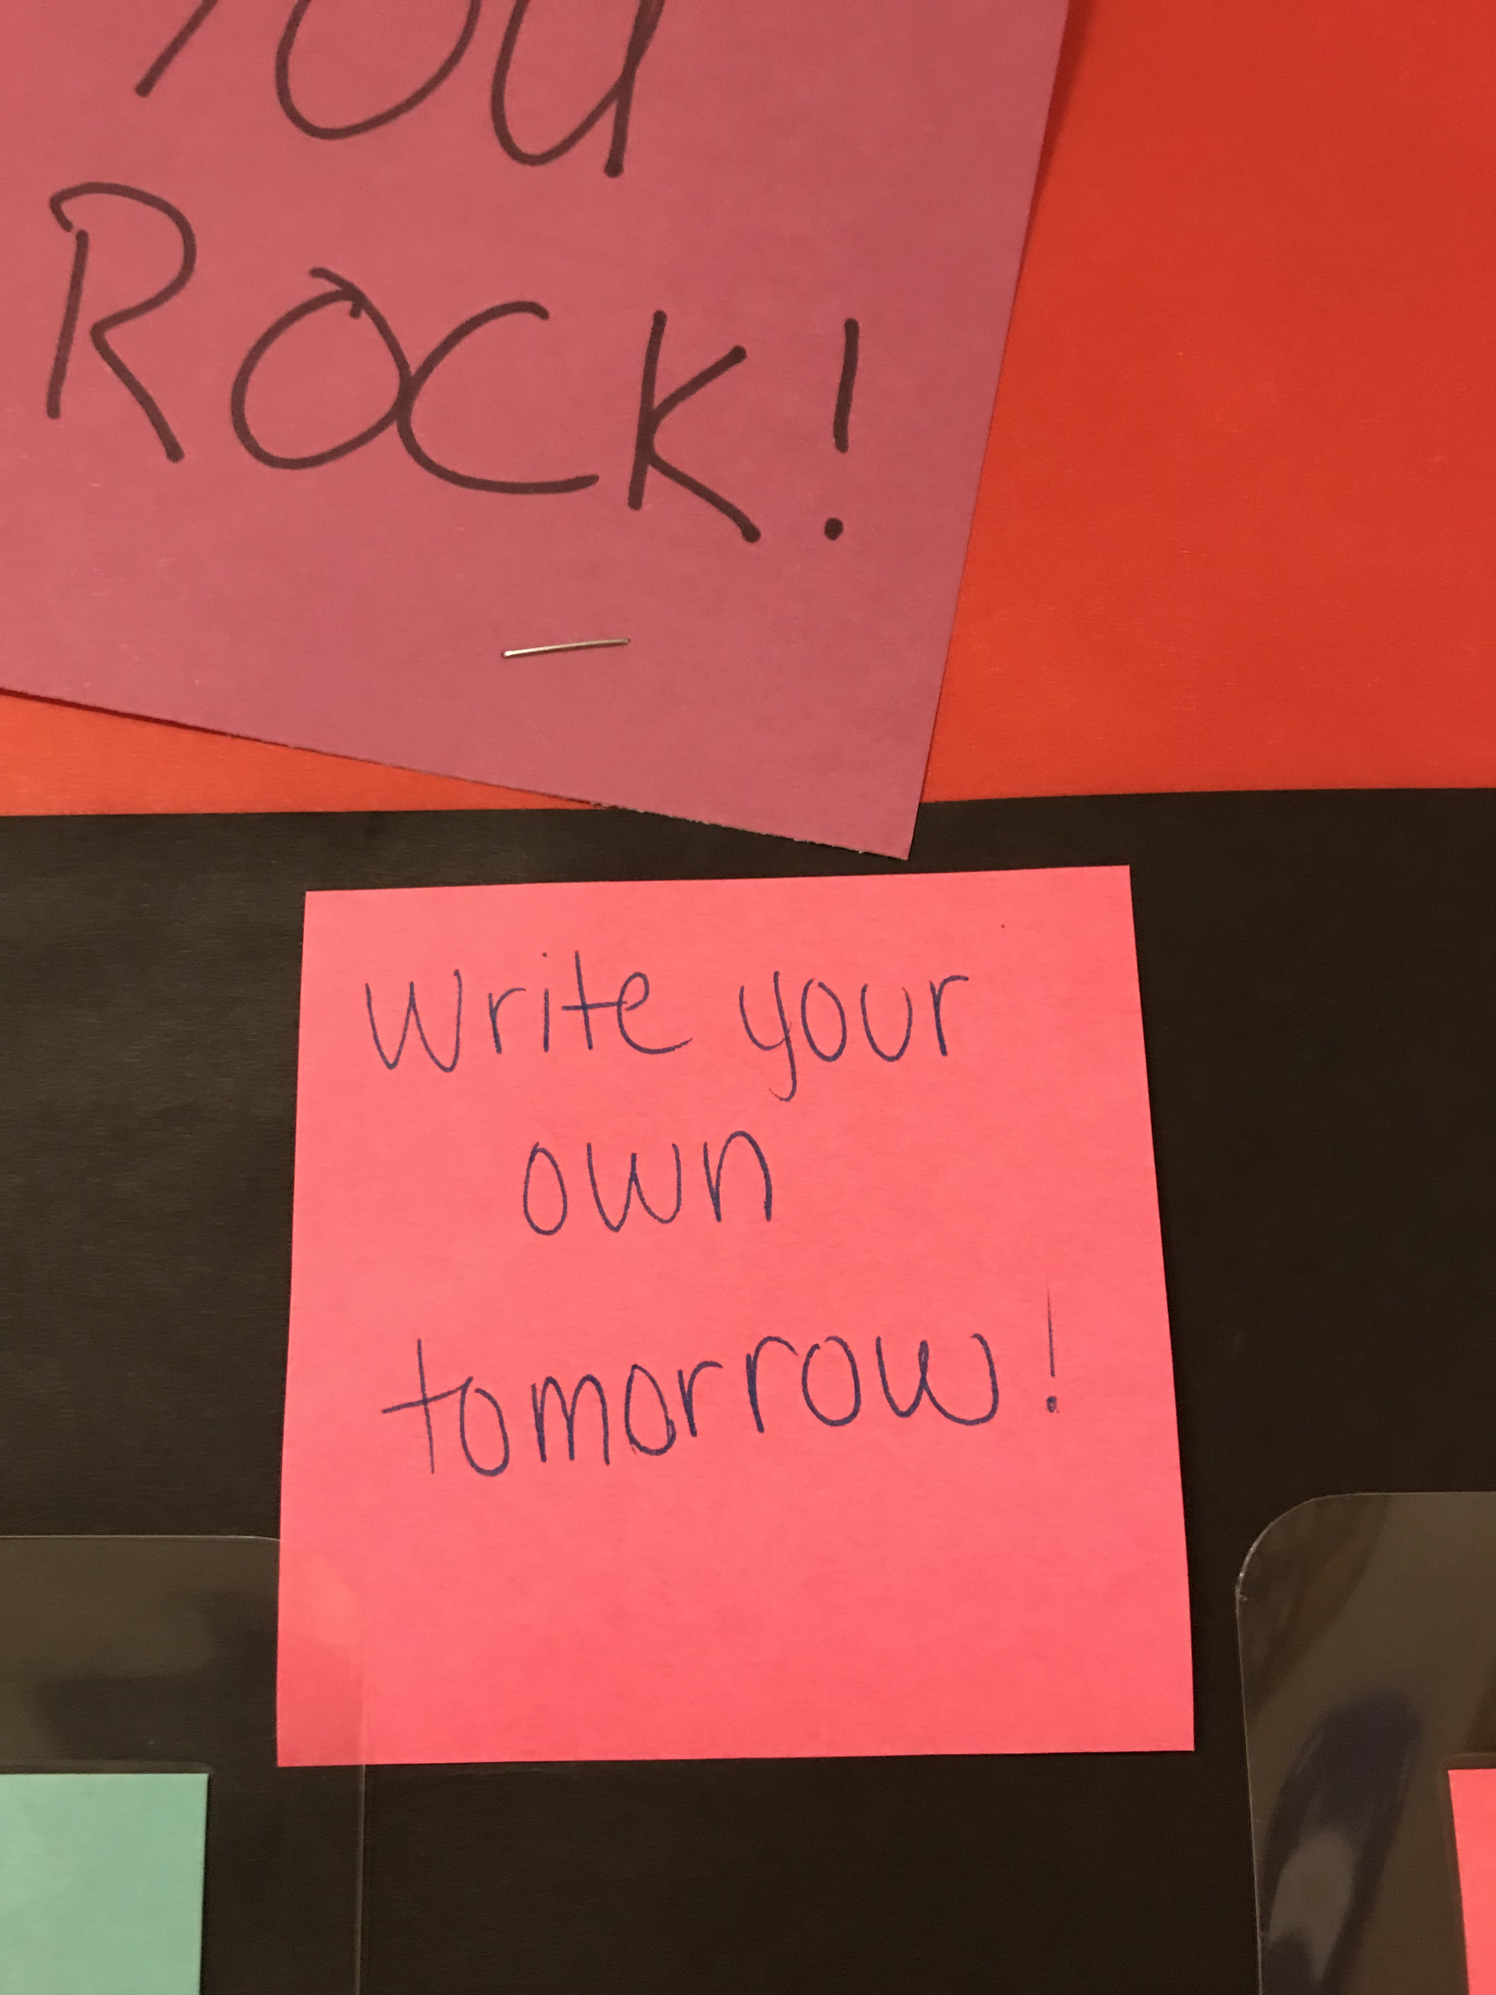
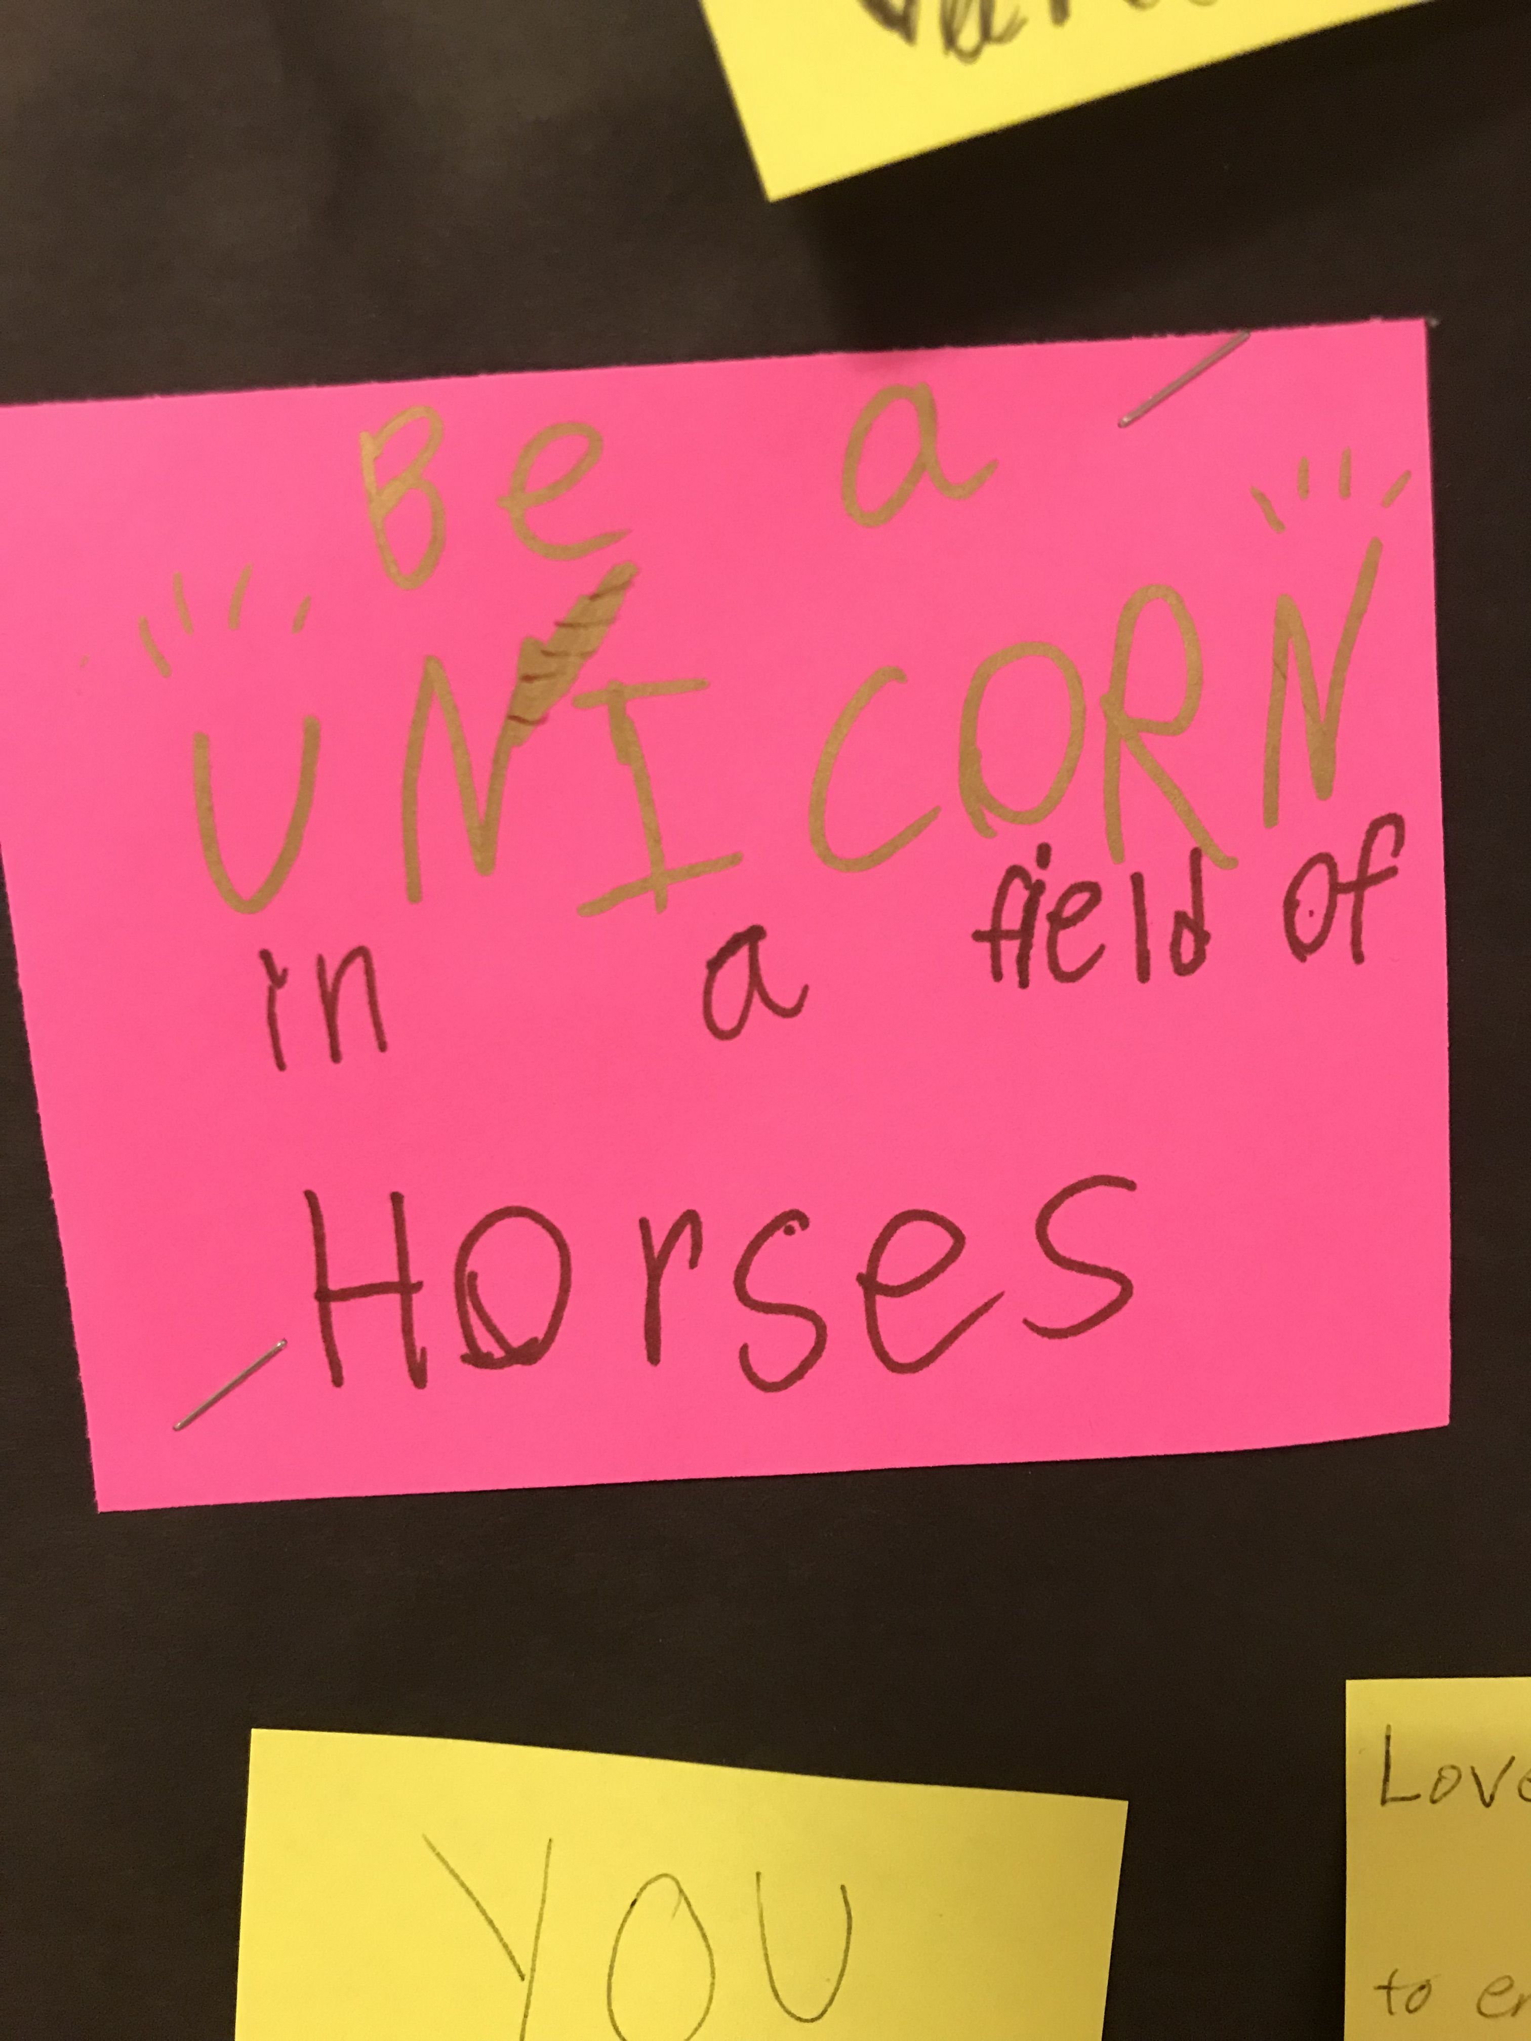
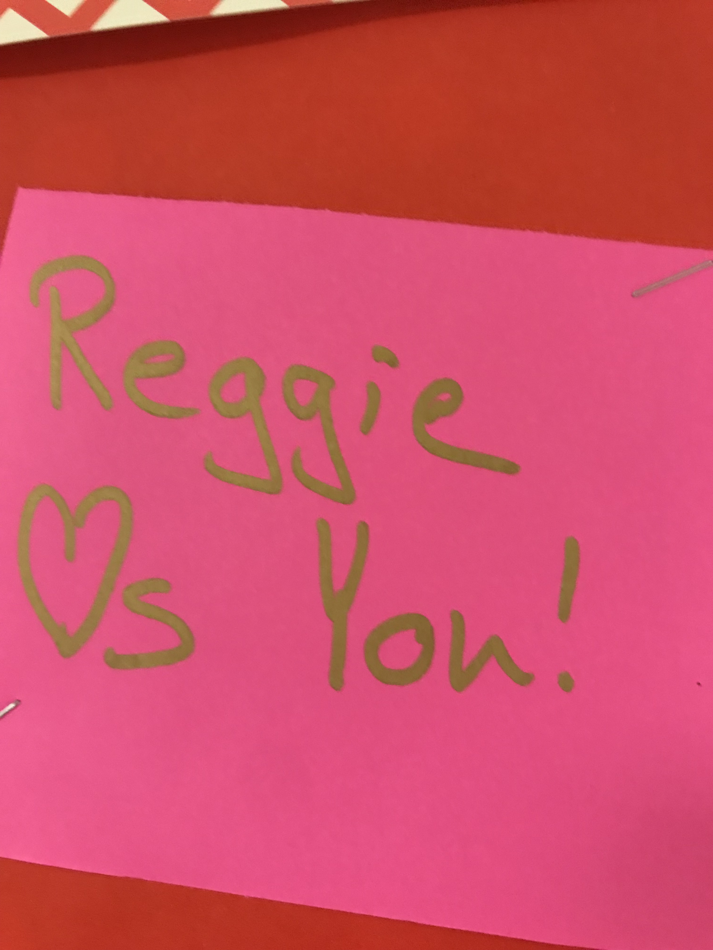

Slide 28
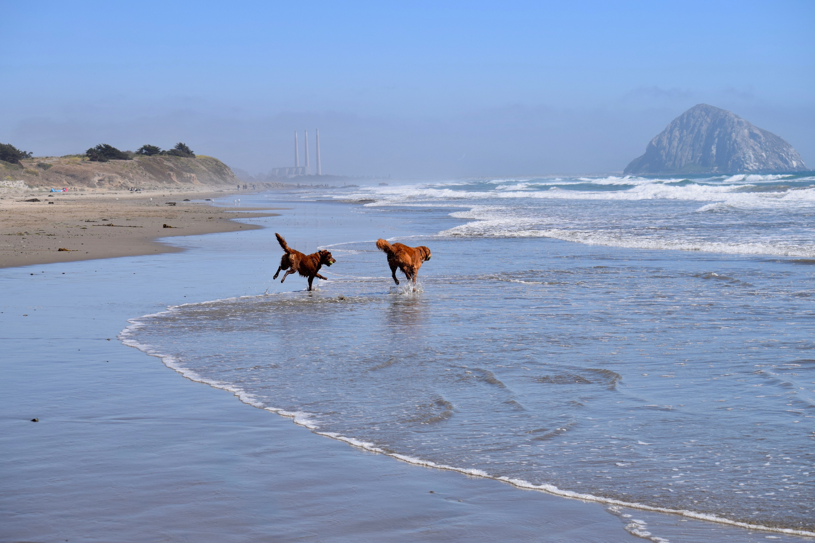
Thank you! And Have the Day you Deserve

